Slide 1
Computer Graphics with OpenGL
Dr. Alpaslan Duysak

Slide 2
Computer graphics is about simulation, abstraction, and representation of light and matter
  Interaction of light with matter
    To simulate the glossy sheen of car paint
    Or the waxy translucence of leaves and human skin
    Or the self-shadowing effects of hair
  Interaction of matter with matter
    Physics of objects colliding and deforming
    Fluid mechanics of water, or fire, or smoke
    Structural physics of cloth

Slide 3
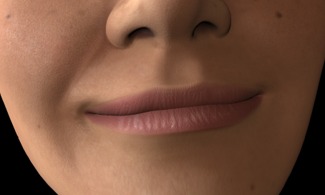
Skin shader from “Shrek”

Slide 4
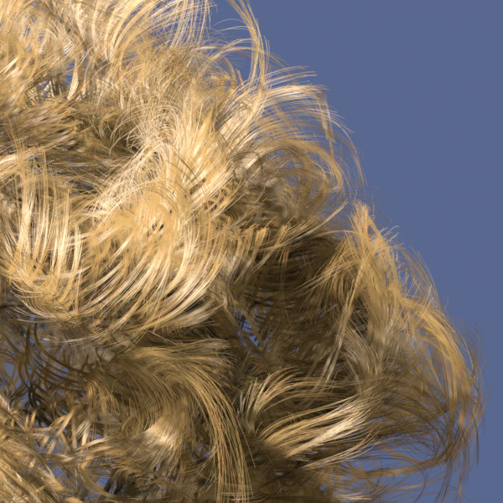
Hair

Slide 5
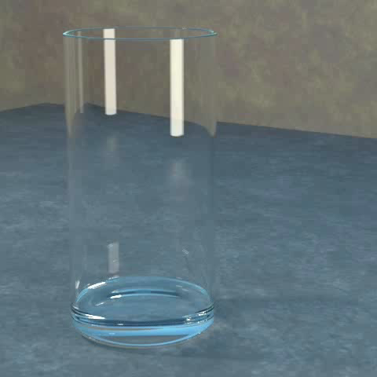
Simulating Water

Slide 6




Slide 7
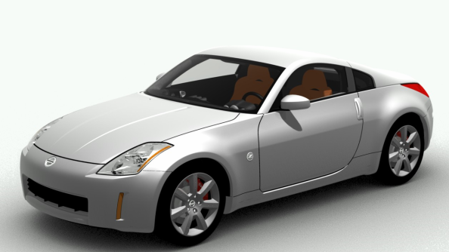
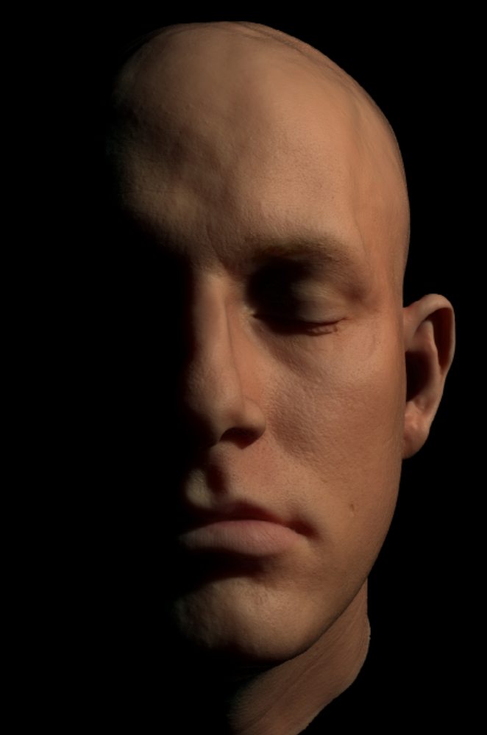
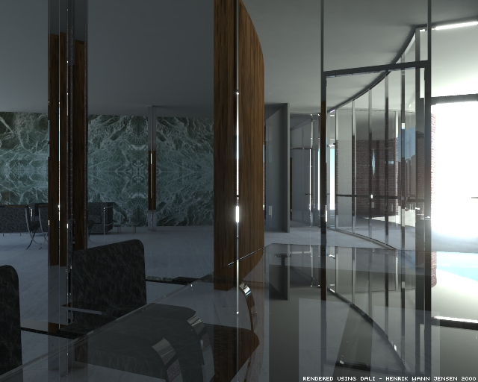

Slide 8
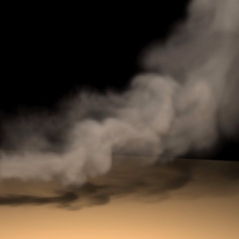
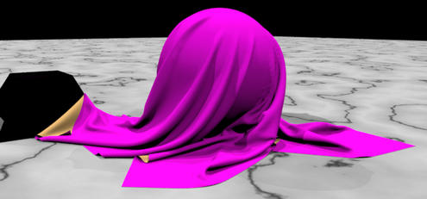

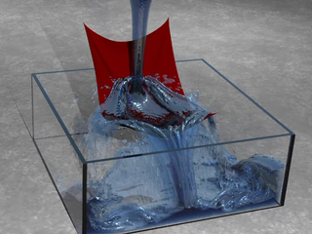

Slide 9
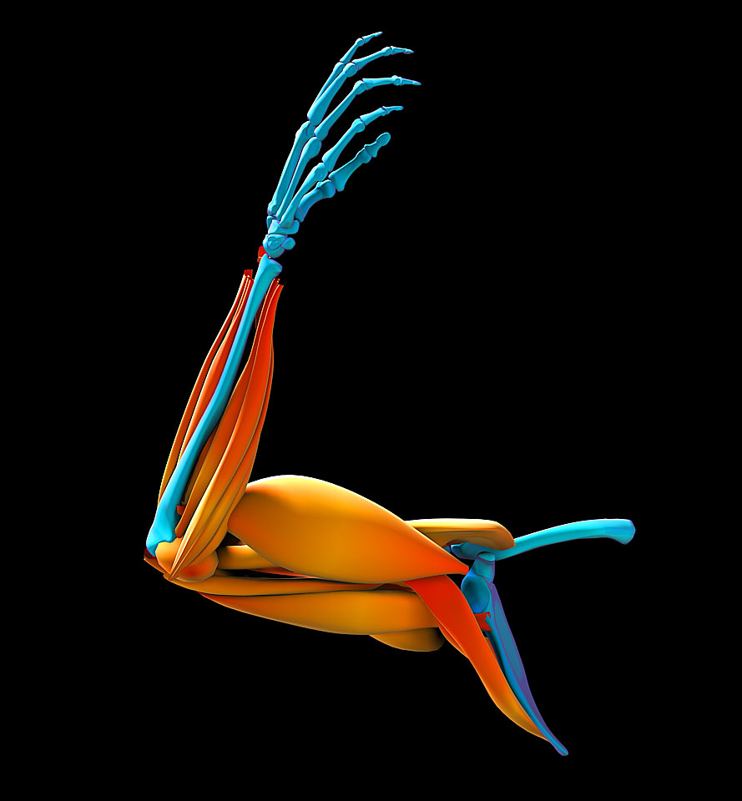
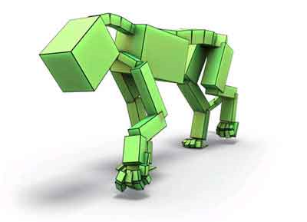
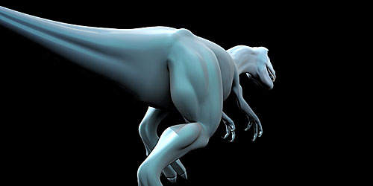
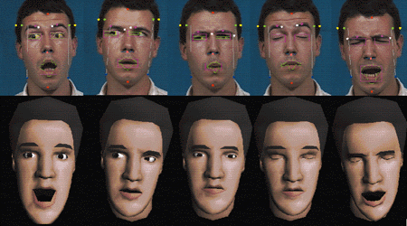

Slide 10
Realism?
The quest of computer graphics is often described as photorealism
  Create images that cannot be distinguished from a photograph
  This requires modeling and simulation of optics, physics, and human perception
But much of computer graphics concerns directed unreality
  Things that don’t or can’t exist: dinosaurs, ghosts, talking mice
  Controlled simulation, e.g. a puff of smoke that forms a word
  Shadows that obey director’s sense of atmosphere, not optics
  Nothing! Removing elements from images or scenes
And sometimes the goal is not realism but depiction or abstraction

Slide 11
Distinction: realism vs. speed
Two general camps in computer graphics:
  Realistic graphics
    Generate images offline for playback later
    Use: movies, television
    Rendering time frame: seconds to hours
    Rendering resources: high-end computer cluster, gigabytes of data
  Interactive graphics
    Generate images dynamically as user interacts with system
    Use: video games, CAD, virtual reality
    Rendering time frame: 10-30 milliseconds
    Rendering resources: cell phone to PC, megabytes of data

Slide 12
Computer graphics: the view from ten thousand feet
Modeling
  How to represent shape computationally
Animation
  How to represent, simulate, and control how things move
Illumination
  How to model the interaction of light with matter
Rendering
  How to generate an image from these representations

Slide 13
Modeling
How do we represent shape in computer graphics?
  Many, many different ways
    Splines, subdivision surfaces, voxels, metaballs, geometry images…
  Lowest common denominator: the polygonal mesh
    Represent surface with a faceted approximation
    Mesh = list of vertices (3D points)
    + list of polygons (which vertices are connected to which)
    Might also store geometric attributes (color, orientation, curvature…)

Slide 14
Animation
How do we represent, simulate, and control how things move?
  One possibility: purely with the laws of physics
    E.g., the Navier-Stokes equations can guide a fluid mechanics simulation to produce realistic-looking water, smoke, and clouds
    Computationally tricky, hard to control
  Another possibility: purely by hand
    E.g., the animators behind Stuart Little have a control panel with literally hundreds of dials…
    Powerful technique, doesn’t scale well
  Another possibility: use measured data
    Motion capture techniques record (for example) an actor performing
    Can then play back that motion, using it to control simulated character
    Tricky to blend motions or apply to different characters/situations

Slide 15
Illumination
How do we model the interaction of light with matter?
  Enormously complex problem: real-world light
    Bounces off of every surface
    Spans an incredible dynamic range
  Common approximations:
    Tricolor spectrum (RGB)
    No shadows, no indirect illumination
    No reflection/refraction/diffraction/polarization/participating media
  Again, we often want controlled unrealism
    E.g., negative lights that cast shadows not illumination
    Much of cinematic lighting is unrealistic, for effect and for balance

Slide 16
Rendering
How do we generate an image from these representations?
  Often very different answers for offline and interactive rendering
  Offline rendering uses specialized software and techniques such as path tracing to model the optics of a scene
  Interactive rendering requires specialized computer hardware for rasterizing polygons into pixels

Slide 17
Computer graphics careers & studies
Computer graphics in practice is wonderfully interdisciplinary
  Science: study the phenomena we are trying to re-create
  Engineering: build the hardware and software to make it happen
  Art: conceive the vision that drives the process
  Media studies: Examine this new media and its place in society
Film and video game studios are teams of artists & engineers working side-by-side toward a shared vision

Slide 18
Computer Graphics Systems
Graphical
Model
Rendering
Parameters
Rendering
Output Device

Slide 19
Output Devices
Vector Devices
  Lasers for example
Raster Devices
  CRT, LCD, bitmaps, etc.
  Most output devices are 2D
  Can you name any 3D output devices?

Slide 20
Graphical Models
2D and 3D objects
  Triangles, quadrilaterals, polygons
  Spheres, cones, boxes
Surface characteristics
  Color, reaction to light
  Texture
Composite objects
  Other objects and their relationships to each other
Lighting, fog, etc.
Much, much more…

Slide 21
Install
Microsoft Developer Studio
glut32.dll to %WinDir%\System
glut32.lib to $(MSDevDir)\..\..\VC98\lib
glut.h to $(MSDevDir)\..\..\VC98\include\GL.

Slide 22
What is OpenGL
A low-level graphics rendering and imaging library
A layer of abstraction between graphics hardware and an application program
An API to produce high-quality, color images of 3D objects
A procedural rather than a descriptive graphics language
An Operating system and Hardware platform independent
  X Window System under UNIX
  Microsoft Windows or Windows NT
  IBM OS/2
  Apple Mac OS

Slide 23
What is OpenGL
OpenGL as a Renderer
Geometric primitives
  points, lines and polygons
Image Primitives
  images and bitmaps
separate pipeline for images and geometry
  linked through texture mapping
Rendering depends on state
  colors, materials, light sources, etc

Slide 24
What is OpenGL
OpenGL is a library (700 functions) for rendering computer graphics. Generally, there are two operations that you do with OpenGL:
draw something
change the state of how OpenGL draws
OpenGL has two types of things that it can render:
geometric primitives and image primitives.
Geometric primitives are points, lines and polygons.
Image primitives are bitmaps and graphics images (i.e. the pixels that you might extract from a JPEG image)
Additionally, OpenGL links image and geometric primitives together using
texture mapping.

Slide 25
What is OpenGL
OpenGL is window and operating system independent. To integrate it into
various window systems, additional libraries are used.
Every window system has its own unique library and functions to do this:
• GLX for the XWindows system, common on Unix platforms
• AGL for the Apple Macintosh
• WGL for Microsoft Windows
OpenGL also includes a utility library, GLU, to simplify common tasks such as:
rendering quadric surfaces (i.e. spheres, cones, cylinders, etc.)
Finally to simplify programming and window system dependence, we’ll be
using the freeware library, GLUT.
GLUT is a public domain window system independent toolkit for making simple OpenGL applications.
It simplifies the process of creating windows, working with events in the window system and handling animation.

Slide 26
What is OpenGL
Header Files
  #include <gl.h>
  #include <glu.h>
  #include <glut.h>
Libraries
  Glut32.dll

Slide 27
What is OpenGL
Header files describe all of the function calls, their parameters and defined constant values to the compiler. OpenGL has header files for GL (the core library), GLU (the utility library), and GLUT (freeware windowing toolkit).
Note: glut.h includes gl.h and glu.h. On Microsoft Windows, including only glut.h is recommended to avoid warnings about redefining Windows macros.
Libraries are the operating system dependent implementation of OpenGL on the system you’re using. Each operating system has its own set of libraries. For Unix systems, the OpenGL library is commonly named libGL.so and for Microsoft Windows, it’s named opengl32.lib.

Slide 28
SGI and GL
Silicon Graphics (SGI) revolutionized the graphics workstation by implementing the pipeline in hardware (1982)
To use the system, application programmers used a library called GL
With GL, it was relatively simple to program three dimensional interactive applications

Slide 29

OpenGL
The success of GL lead to OpenGL (1992), a platform-independent API that was
  Easy to use
  Close enough to the hardware to get excellent performance
  Focus on rendering
  Omitted windowing and input to avoid window system dependencies

Slide 30
OpenGL Evolution
Controlled by an Architectural Review Board (ARB)
  Members include SGI, Microsoft, Nvidia, HP, 3DLabs,IBM,…….
  Relatively stable (present version 1.4……..)
    Evolution reflects new hardware capabilities
      3D texture mapping and texture objects
      Vertex programs
  Allows for platform specific features through extensions

Slide 31
OpenGL Libraries
OpenGL core library
  OpenGL32 on Windows
  GL on most unix/linux systems
OpenGL Utility Library (GLU)
  Provides functionality in OpenGL core but avoids having to rewrite code
Links with window system
  GLX for X window systems
  WGL for Widows
  AGL for Macintosh

Slide 32
GLUT
OpenGL Utility Library (GLUT)
  Provides functionality common to all window systems
    Open a window
    Initialize OpenGL State
    Get input from mouse and keyboard
    Menus
    Event-driven
  Code is portable but GLUT lacks the functionality of a good toolkit for a specific platform
    Slide bars
  Not official part of OpenGL

Slide 33
Software Organization
application program
OpenGL Motif
widget or similar
GLUT
GLX, AGL
or WGL
GLU
X, Win32, Mac O/S
GL
software and/or hardware

Slide 34
OpenGL Architecture
Geometric
pipeline
Immediate Mode
Per Vertex
Operations &
Primitive
Assembly
Polynomial
Evaluator
CPU
Display
List
Rasterization
Per Fragment
Operations
Frame
Buffer
Texture
Memory
Pixel
Operations

Slide 35
OpenGL Functions
Primitives
  Points
  Line Segments
  Polygons
Attributes
Transformations
  Viewing
  Modeling
Control
Input (GLUT)

Slide 36
OpenGL State
OpenGL is a state machine
OpenGL functions are of two types
  Primitive generating
    Can cause output if primitive is visible
    How vertices are processes and appearance of primitive are controlled by the state
  State changing
    Transformation functions
    Attribute functions

Slide 37
Lack of Object Orientation
OpenGL is not object oriented so that there are multiple functions for a given logical function, e.g. glVertex3f, glVertex2i, glVertex3dv,…..
Underlying storage mode is the same
Easy to create overloaded functions in C++ but issue is efficiency

Slide 38
OpenGL Command Notation
glVertex3fv( ... )
Number of
components
Data Type
Vector
b - byte
ub - unsigned byte
s - short
us - unsigned short
i - int
ui - unsigned int
f - float
d - double
omit “v” for
scalar form
glVertex2f( x, y )
2 - (x,y)
3 - (x,y,z)
4 - (x,y,z,w)

Slide 39
Preliminaries
Header files
  #include <gl.h>
  #include <glu.h>
  #include <glut.h>
GL enumerated types
  for platform independence
  GLbyte, GLshort, GLushort, GLint, GLuint, GLsizei, GLfloat, GLdouble, GLclampf, GLclampd, GLubyte, GLboolean, GLenum, GLbitfield

Slide 40
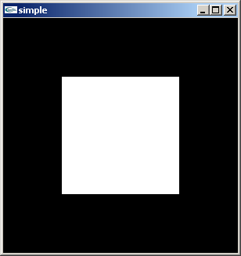
A Simple Program
Generate a square on a solid background

Slide 41
simple.c
#include <glut.h>
void mydisplay(){
glClear(GL_COLOR_BUFFER_BIT);
glBegin(GL_POLYGON);
glVertex2f(-0.5, -0.5);
glVertex2f(-0.5, 0.5);
glVertex2f(0.5, 0.5);
glVertex2f(0.5, -0.5);
glEnd();
glFlush();
}
int main(int argc, char** argv){
glutCreateWindow("simple");
glutDisplayFunc(mydisplay);
glutMainLoop();
}

Slide 42
Event Loop
Note that the program defines a display callback function named mydisplay
  Every glut program must have a display callback
  The display callback is executed whenever OpenGL decides the display must be refreshed, for example when the window is opened
  The main function ends with the program entering an event loop

Slide 43
The Main Program
We begin with the basic elements of how to create a window. OpenGL was intentionally designed to be independent of any Specific window system. As a result, a number of the basic window operations are not provided in OpenGL.
Therefore, a separate library called GLUT or OpenGL Utility Toolkit was created to provide these functions.
Basically, GLUT provides the necessary tools for requesting windows to be created and providing interaction with I/O devices

Slide 44
Program Structure
Most OpenGL programs have a similar structure that consists of the following functions
  main():
    defines the callback functions
    opens one or more windows with the required properties
    enters event loop (last executable statement)
  init(): sets the state variables
    viewing
    Attributes
  callbacks
    Display function
    Input and window functions

Slide 45
main.c
#include <glut.h>
int main(int argc, char** argv)
{
glutInit(&argc,argv);
glutInitDisplayMode(GLUT_SINGLE|GLUT_RGB);
glutInitWindowSize(500,500);
glutInitWindowPosition(0,0);
glutCreateWindow("simple");
glutDisplayFunc(mydisplay);
init();
glutMainLoop();
}
includes gl.h
define window properties
display callback
set OpenGL state
enter event loop

Slide 46
GLUT functions
glutInit allows application to get command line arguments and initializes system
gluInitDisplayMode requests properties of the window -
-RGB color
  Single buffering
glutWindowSize in pixels
glutWindowPosition from top-left corner of display
glutCreateWindow create window with title “….”
glutDisplayFunc display callback
glutMainLoop enter infinite event loop

Slide 47
glutInit()
The arguments allows application to get command line arguments (argc and argv) and initializes system
This procedure must be called before any others.
It processes (and removes) command-line arguments that may be of interest to GLUT and the window system and does general initialization of GLUT and OpenGL.

Slide 48
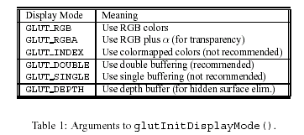
glutInitDisplayMode()
This function performs initializations informing OpenGL how to set up its frame buffer.
The argument to glutInitDisplayMode() is a logical-or (using the operator “|”) of a number of possible options, which are given in Table 1.

Slide 49
glutInitWindowSize()
This command specifies the desired width and height of the graphics window. The general form is:
glutInitWindowSize(int width, int height)
The values are given in numbers of pixels.
glutInitPosition()
This command specifies the location of the upper left corner of the graphics window. The form is
glutInitWindowPosition(int x, int y)
where the (x, y) coordinates are given relative to the upper left corner of the display. Thus, the arguments (0, 0) places the window in the upper left corner of the display.

Slide 50
glutCreateWindow()
This command actually creates the graphics window. The general form of the command is
glutCreateWindowchar(*title)
where title is a character string. Each window has a title, and the argument is a string which specifies the window’s title.

Slide 51
init.c
black clear color
void init()
{
glClearColor (0.0, 0.0, 0.0, 1.0);
glColor3f(1.0, 1.0, 1.0);
glMatrixMode (GL_PROJECTION);
glLoadIdentity ();
glOrtho(-1.0, 1.0, -1.0, 1.0, -1.0, 1.0);
}
opaque window
fill with white
viewing volume

Slide 52
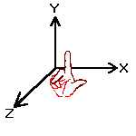
3D coordinate systems
Y
Y
Z
X
X
Z
Right-Hand
Coordinate System
Left-Hand
Coordinate System
OpenGL uses this!
Direct3D uses this!

Slide 53
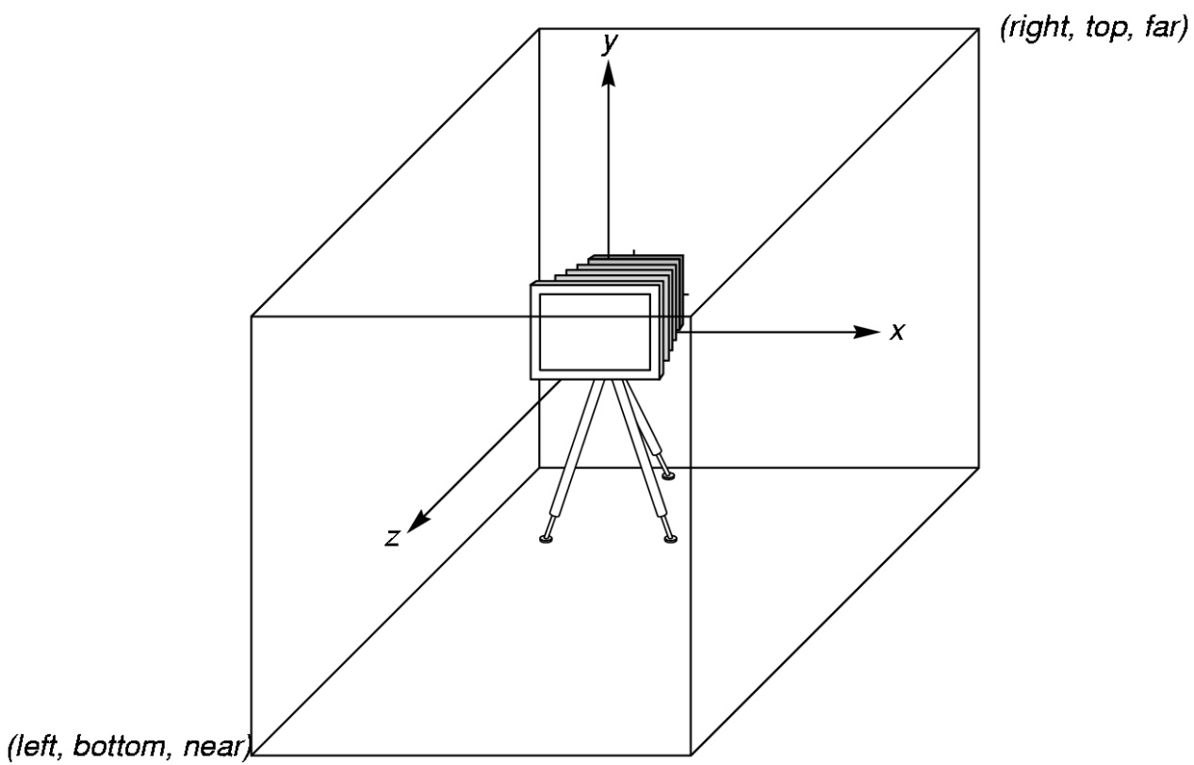
OpenGL Camera
OpenGL places a camera at the origin pointing in the negative z direction
The default viewing volume
is a box centered at the
origin with a side of
length 2

Slide 54
mydisplay
void mydisplay()
{
glClear(GL_COLOR_BUFFER_BIT);
glBegin(GL_POLYGON);
glVertex2f(-0.5, -0.5);
glVertex2f(-0.5, 0.5);
glVertex2f(0.5, 0.5);
glVertex2f(0.5, -0.5);
glEnd();
glFlush();
}

Slide 55
OpenGL Primitives
GL_POINTS
GL_POLYGON
GL_LINES
GL_LINE_STRIP
GL_LINE_LOOP
GL_TRIANGLES
GL_QUAD_STRIP
GL_TRIANGLE_STRIP
GL_TRIANGLE_FAN

Slide 56
Polygon Issues
OpenGL will only display polygons correctly that are
  Simple: edges cannot cross
  Convex: All points on line segment between two points in a polygon are also in the polygon
  Flat: all vertices are in the same plane
User program must check if above true
Triangles satisfy all conditions
nonsimple polygon
nonconvex polygon

Slide 57
Attributes
Attributes are part of the OpenGL and determine the appearance of objects
  Color (points, lines, polygons)
  Size and width (points, lines)
  Stipple pattern (lines, polygons)
  Polygon mode
    Display as filled: solid color or stipple pattern
    Display edges

Slide 58
Constructive Primitives
glBegin()
glEnd()
all OpenGL descriptions of primitives start with glBegin(xxx), where xxx is an OpenGL-defined constant that identifies the OpenGL primitive.

Slide 59
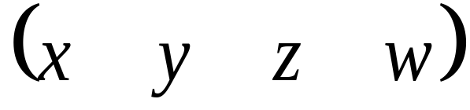
Specifying Primitives
Primitives are described by their vertices
Vertex is a point in space which is used in the construction of a geometric primitive
Described by a homogenous coordinate

Slide 60
Adding Personality to Primitives
State ( or Attributes )
  data required for computing colors for primitives
Examples
  color
  reflectivity
  surface texture

Slide 61
Specifying a Vertex’s Color
Use the OpenGL color command
glColor3f( r, g, b );
Where you specify the color determines how the primitive is shaded
  points only get one color

Slide 62
OpenGL Initalization
We’ll use the init() routine for our one-time OpenGL state initialization
  call after window has been created, but before first rendering call
void init( void )
{
glClearColor( 1.0, 0.0, 0.0, 1.0 );
}

Slide 63
The Color Cube
Green
Yellow
(255,255,0)
(0,255,0)
Cyan
(0,255,255)
White
(255,255,255)
Black
(0,0,0)
Red
Magenta
(255,0,255)
Blue

Slide 64
Color and Shading
Color in RGBA mode is set by specifying the red, green, blue and alpha intensities.
alpha = 1 //opaque
alpha = 0 // transparent

Slide 65
OpenGL Types
Basic numeric types
  GLdouble = double
  GLfloat = float
  GLint = int
  GLshort = short
Mostly you’ll use GLdouble and GLfloat

Slide 66
#include <stdlib.h>
#include <glut.h>
void display(void) {
glClearColor (0.0, 0.0, 0.0, 0.0); //Siyah Rengi seç
glClear(GL_COLOR_BUFFER_BIT); //Pencereyi temizle
glColor3f(1.0, 1.0, 1.0); //çizme rengini beyaz yap
glMatrixMode (GL_PROJECTION); //gözlemleme
glLoadIdentity ();
glOrtho(-1.0, 1.0, -1.0, 1.0, -1.0, 1.0);
glBegin(GL_POLYGON);
glVertex2f(-0.5, -0.5);
glVertex2f(-0.5, 0.5);
glVertex2f(0.5, 0.5);
glVertex2f(0.5, -0.5);
glEnd();
glFlush();
}

Slide 67
int main(int argc, char** argv)
{
glutInit(&argc,argv);
glutInitDisplayMode (GLUT_SINGLE | GLUT_RGB);
glutInitWindowSize(500,500);
glutInitWindowPosition(0,0);
glutCreateWindow("Basit pencere");
glutDisplayFunc(display);
glutMainLoop();
}

Slide 68


